Slide 1
KATHY & ALEXANDRE’S WEDDING
MAY 9TH, 2026
120 GUESTS
CERCLE DE L’UNION INTÉRALLIÉE
WEDDING MOOD BOARD

Slide 2
COLOR PALETTE
MAY 9TH, 2026:
CHURCH CEREMONY: WHITE/GREENERY
BOUQUET: WHITE/GREENERY
COCKTAIL & RECEPTION/DINNER: CORAL/PASTEL PINK/DUSTY BLUE/SOFT GREEN/SOFT WHITE
WELCOME PARTY: CORAL/PASTEL PINK/DUSTY BLUE/SOFT GREEN/SOFT WHITE

Slide 3
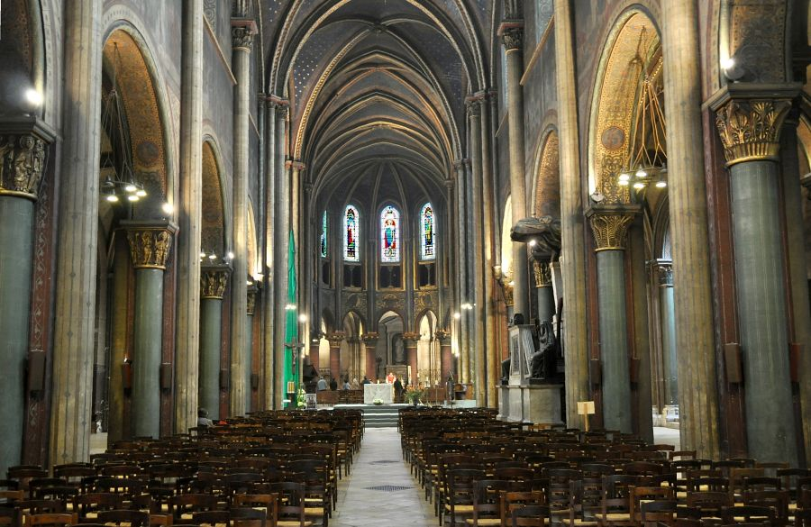
CEREMONY DECOR
The ceremony will take place at Église Saint-Germain-des-Prés, Paris

Slide 4
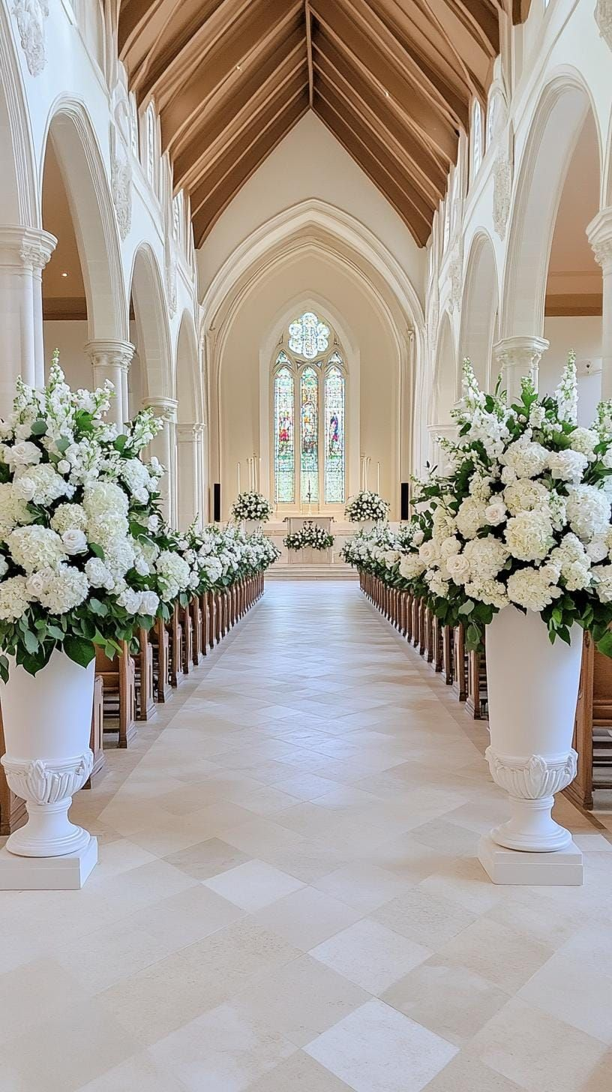
ALTAR DECOR
Tall Refined floral arrangements, as shown in the reference image, will be displayed on either side of the bride and groom
The florals will be presented in antique white, European-style vases, set atop white columns to create a balanced and elegant framing

Slide 5
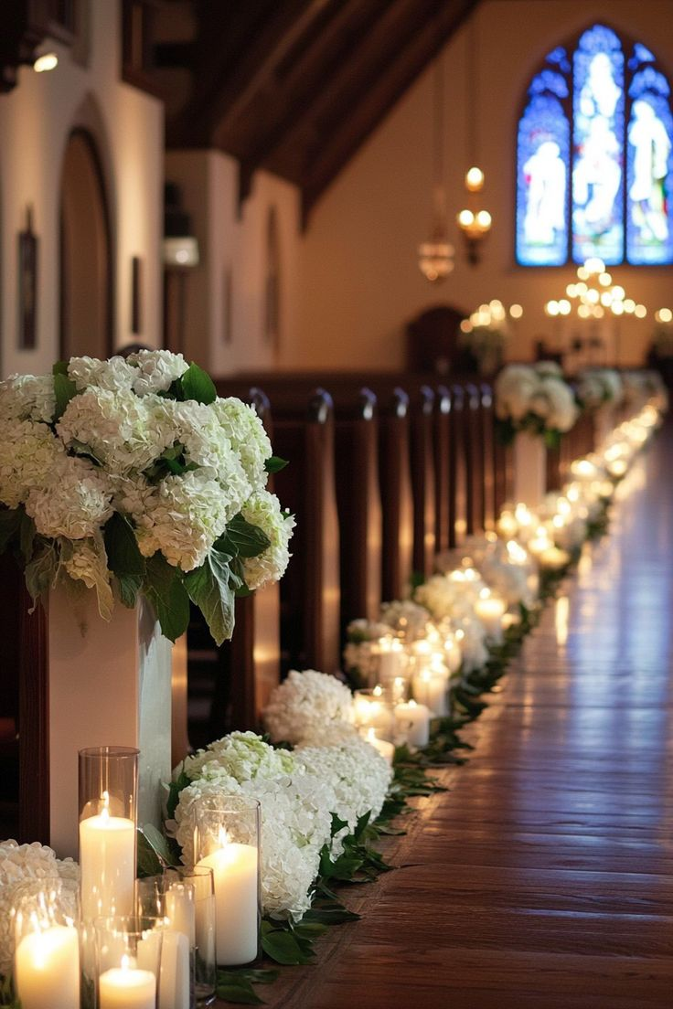
CEREMONY DECOR – AISLE ENTRANCE
White floral arrangements will be positioned on columns at both the entrance and the end of the aisle, elegantly framing the ceremony space

Slide 6
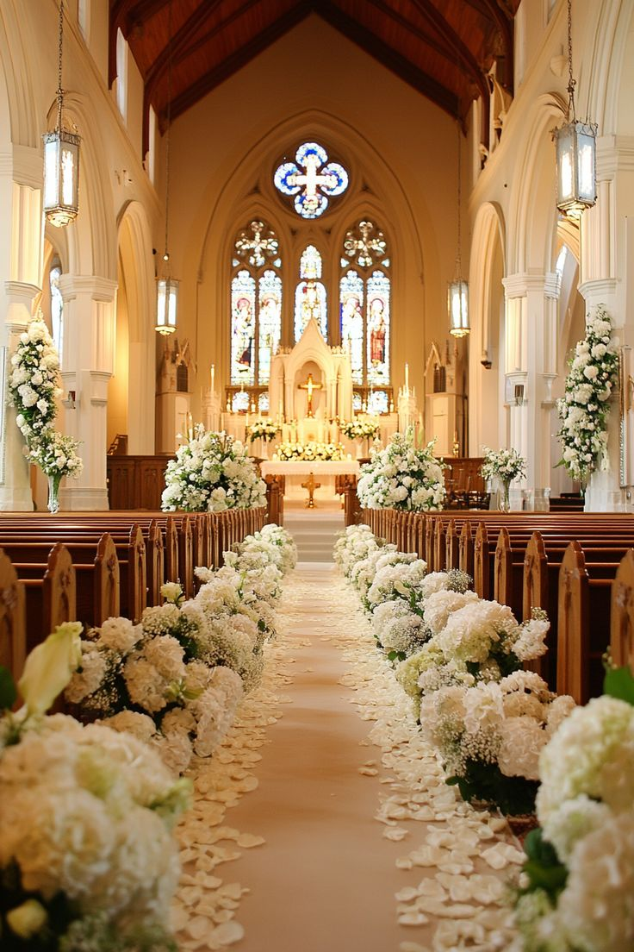
AISLE DECOR
Very minimal greenery and white floral arrangements, will be artfully arranged along both sides of the aisle – no loose petals allowed.

Slide 7
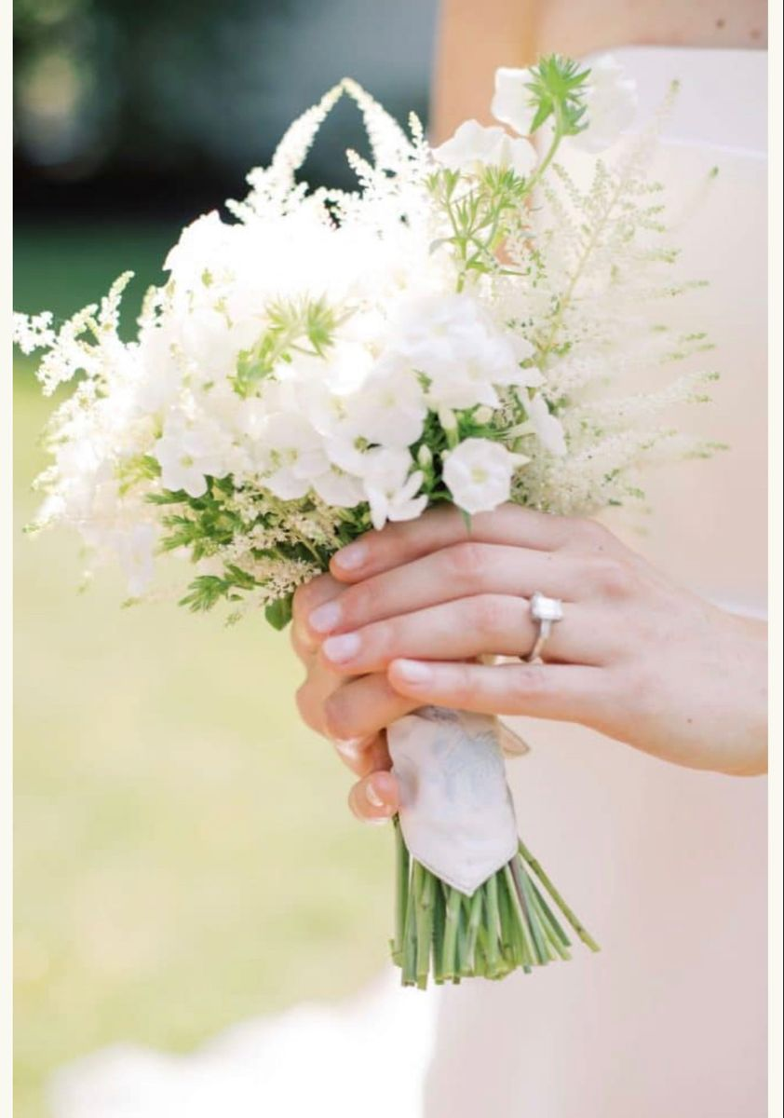
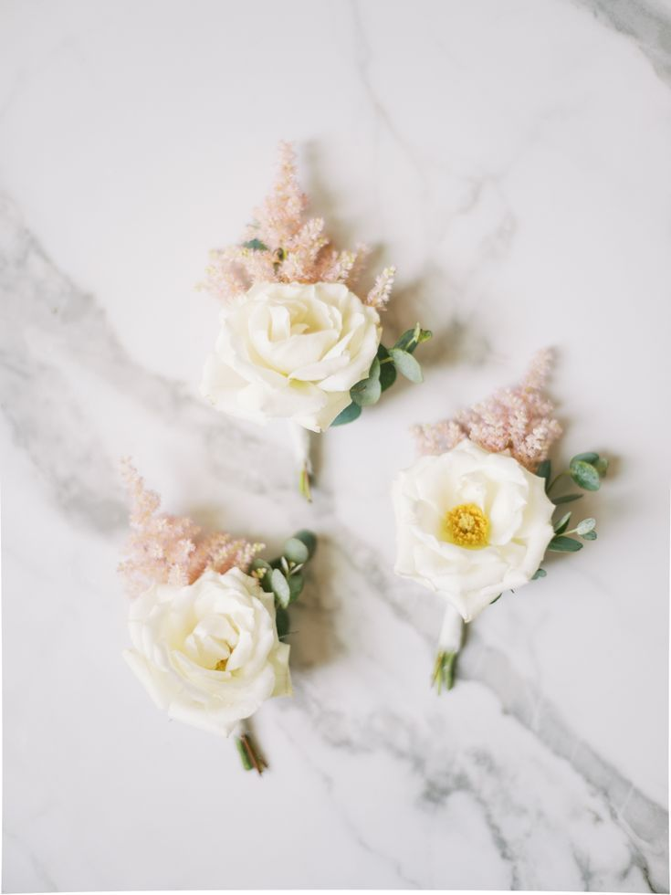
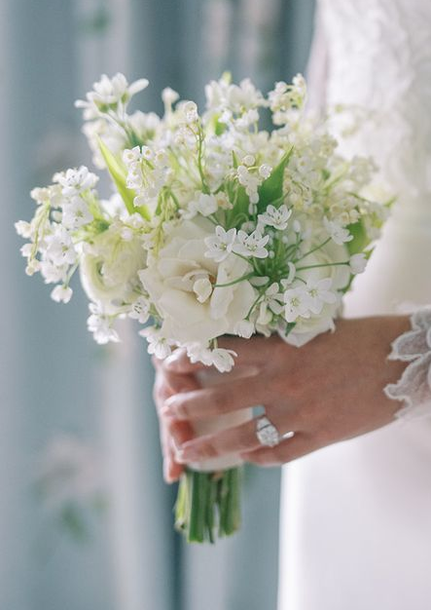
BRIDAL BOUQUET & BOUTONNIERE
Bridal bouquet: The bridal bouquet will be small in size, composed of an airy and refined blend of white spring florals and greenery, inspired by the reference image. The stems will be finished with a white ribbon, delicately tied to create a natural, effortless finish
Boutonniere: As discussed, the boutonniere will feature a wild spring bloom, delicately enhanced with a soft pastel accent

Slide 8
MAID OF HONOR & FLOWER GIRLS BOUQUETS
The bridesmaids’ bouquets will mirror the bride’s bouquet in style, with a slightly smaller scale. As discussed, three bouquets will be created

Slide 9
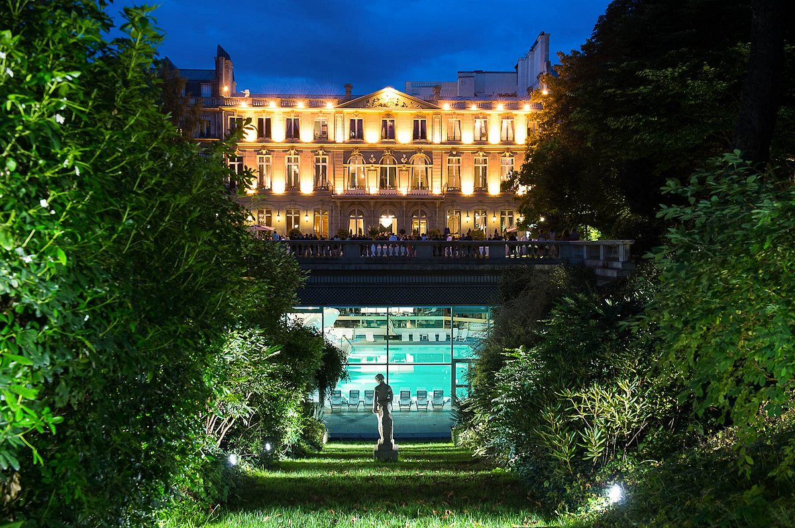
COCKTAIL & RECEPTION DECOR
The cocktail and the reception will take place at Cercle de l’Union Interalliée.

Slide 10
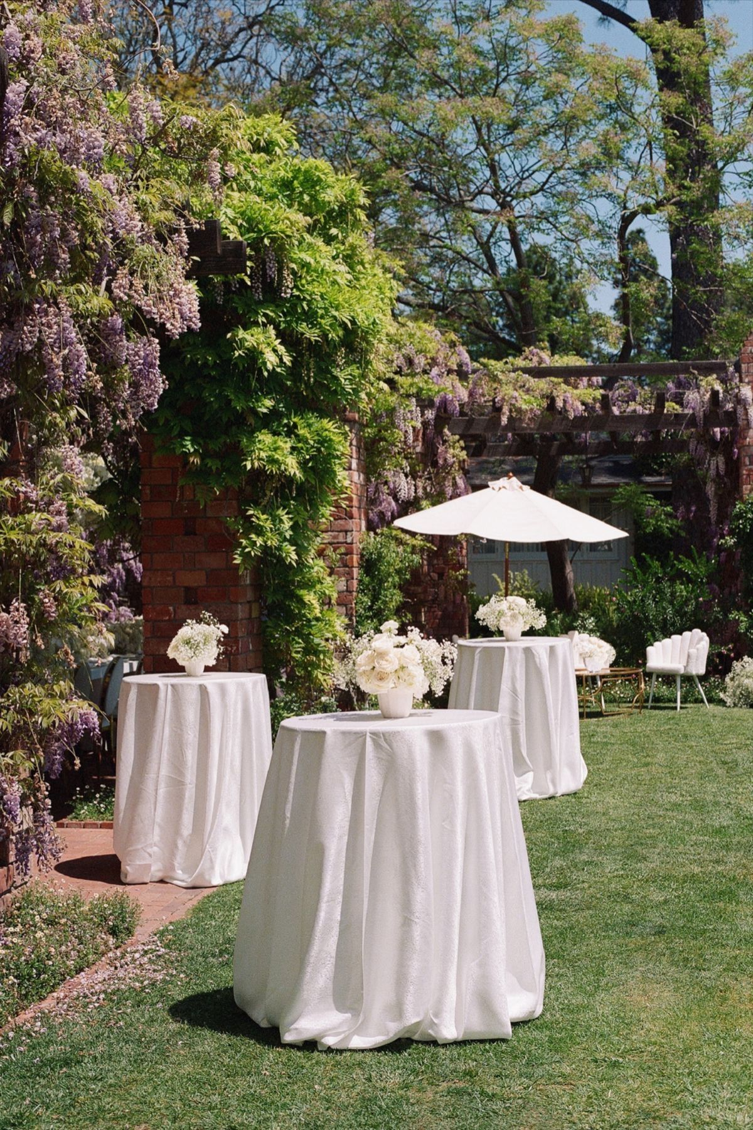
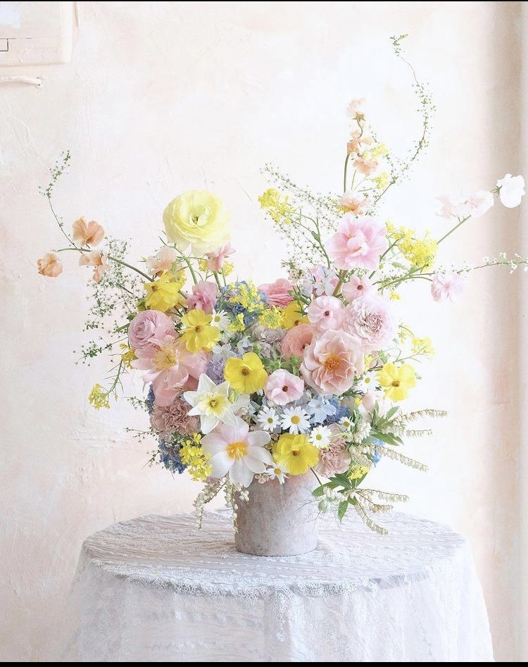
COCKTAIL
During the cocktail hour, a carefully curated arrangement of lounge tables, accented with elegant white drapery cascading on each side, will offer guests an inviting space to unwind in an atmosphere of understated elegance
Each table will feature small delicate floral arrangements in shades of white, coral, and pastel pink, presented in small antique white vases

Slide 11
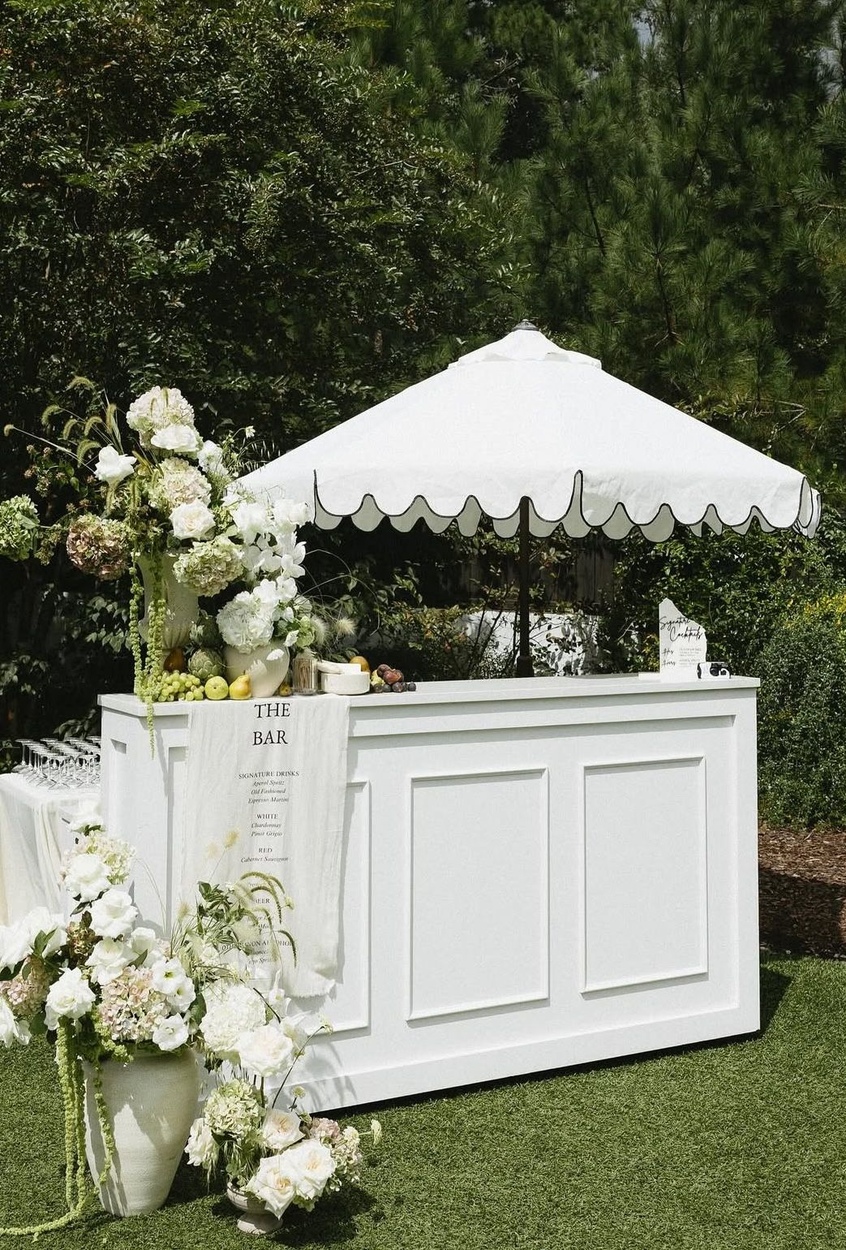
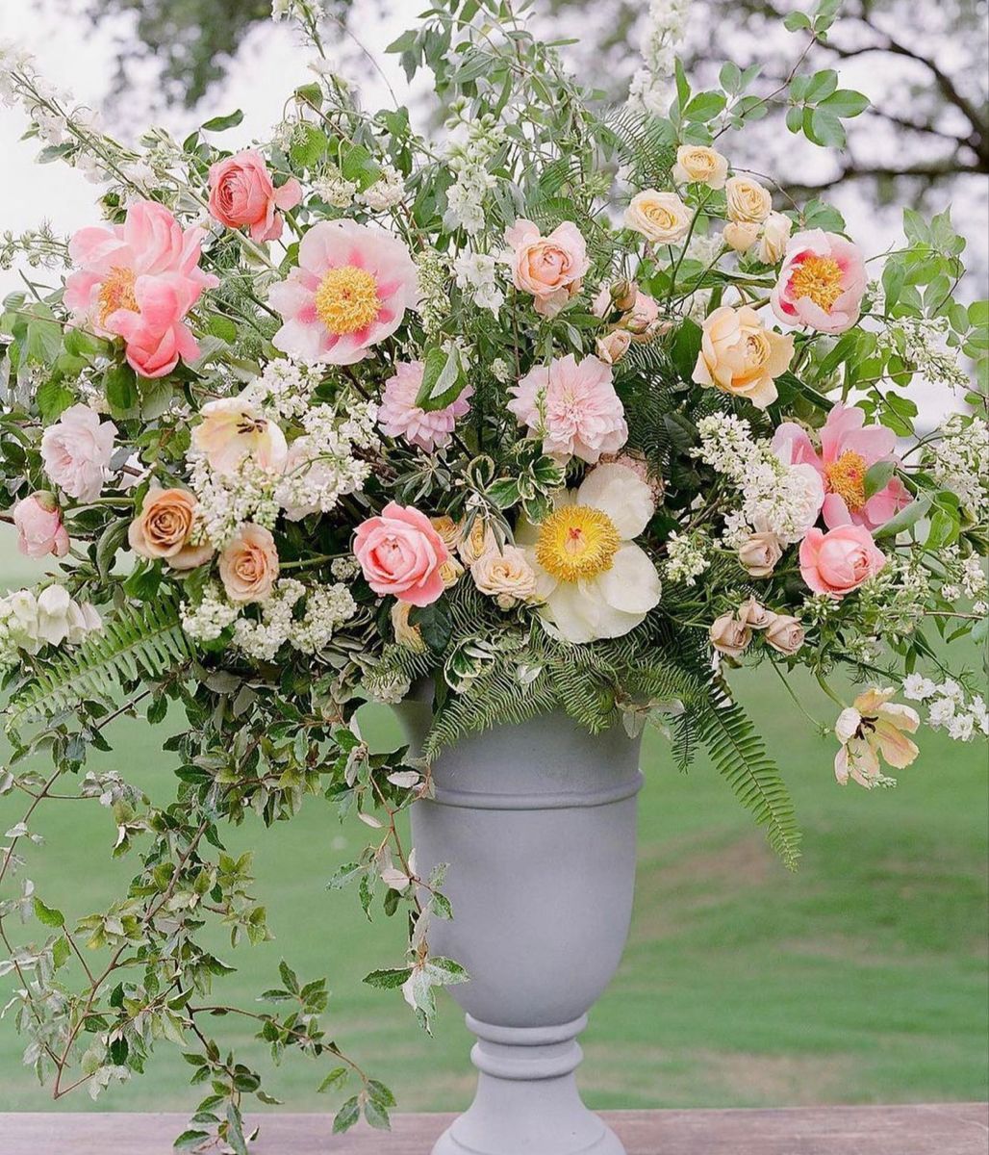
BARS RENTAL & DECOR
A refined white bar, inspired by the provided reference image, will anchor the cocktail space, complemented by one floral arrangement placed at the base displayed in antique white vase
A bespoke banner will be designed and printed, showcasing the selected beverages alongside the names of the bride and groom and the wedding date.
The décor will echo the reference imagery, styled in harmony with the color palette detailed on slide #2

Slide 12
SIGNS
Audrey’s note: To create an harmony between the differents signage I recommend using the same font style and color (as much as possible) – TBC with Kathy a design proof will be sent.

Slide 13
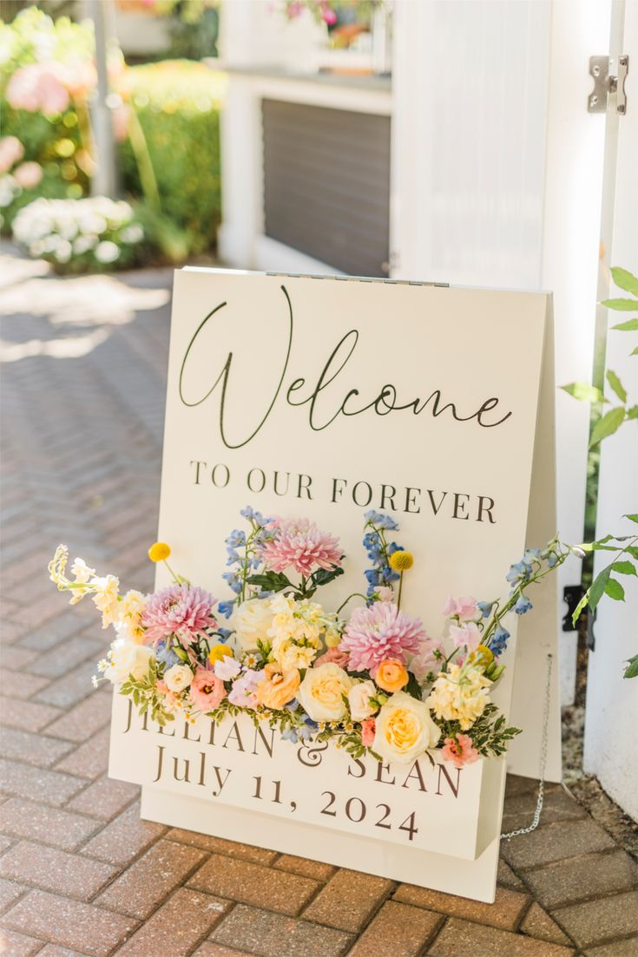
Welcome Sign & Décor
The warm white–toned welcome sign, featuring typography and detailing inspired by the reference image, will be elegantly paired with a floral arrangement in coral, pastel pink, dusty blue, soft white, and accents of verdant greenery, creating a sophisticated and inviting entrance

Slide 14
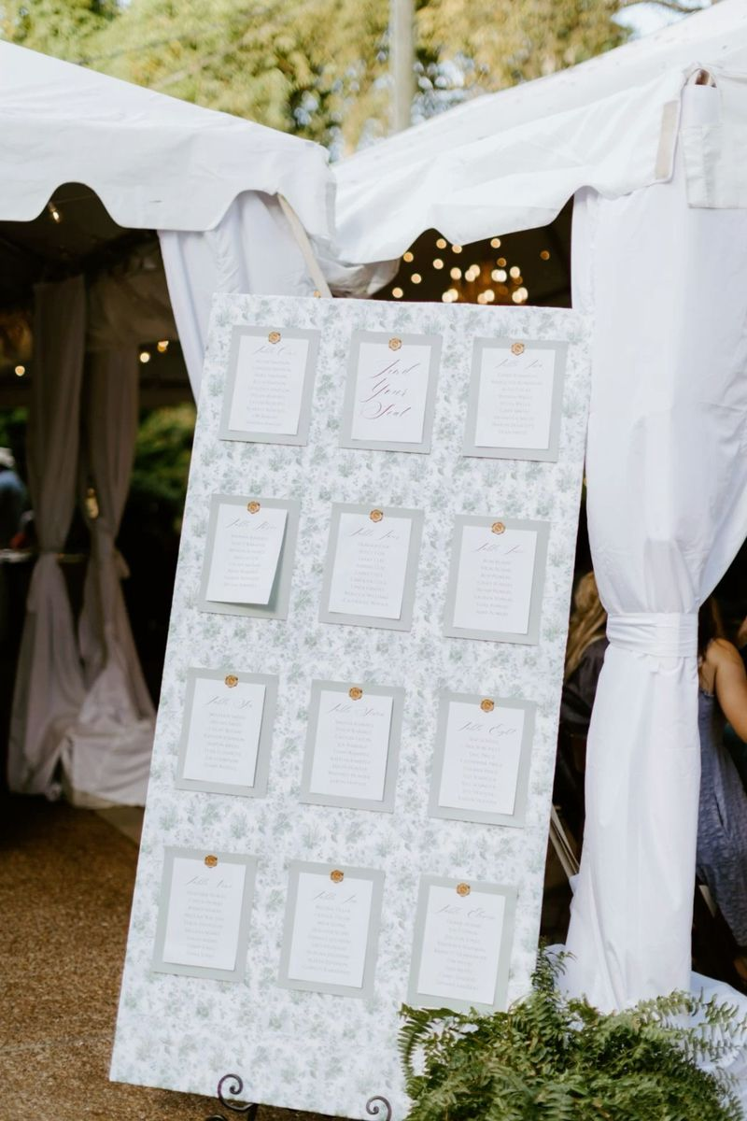
Seating Chart
A refined poster featuring a pastel green spring floral motif, accented with dark green script typography, harmoniously coordinated with the welcome sign
A medium-sized floral arrangement will be displayed at the base of the seating chart, with décor echoing the reference imagery and styled in harmony with the color palette detailed on slide #2

Slide 15
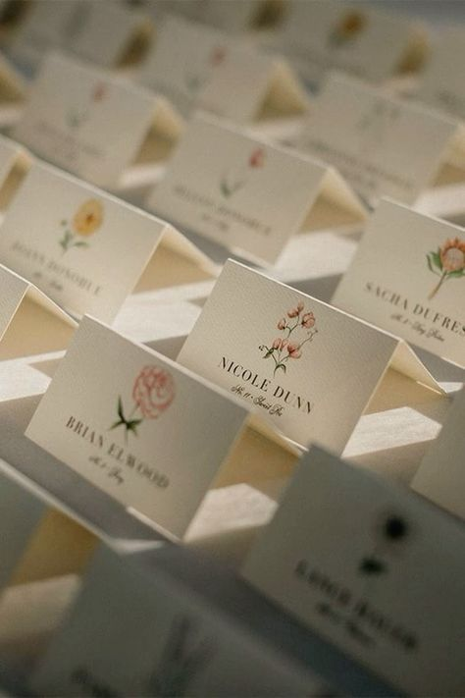
Place Cards
Audrey’s Note:
Please note that place cards are required by the catering staff regardless of round or rectangular tables. For weddings with more than 100 guests, place cards must be placed on each table with assigned seating, showing each guest’s full name, table number, and a meal icon/allergy note to guide the staff.

Slide 16
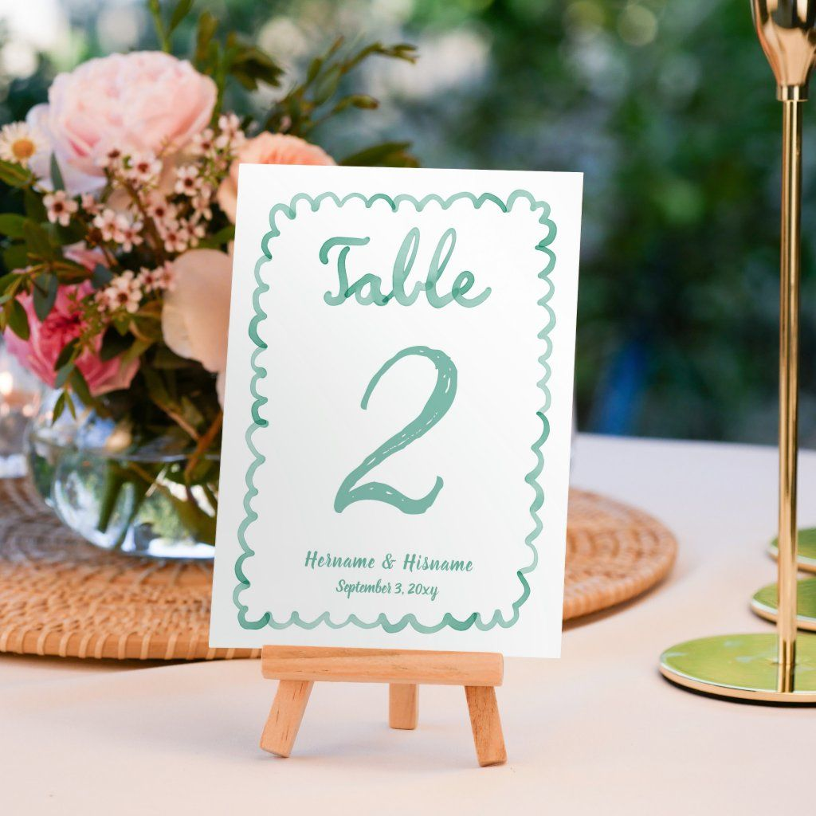
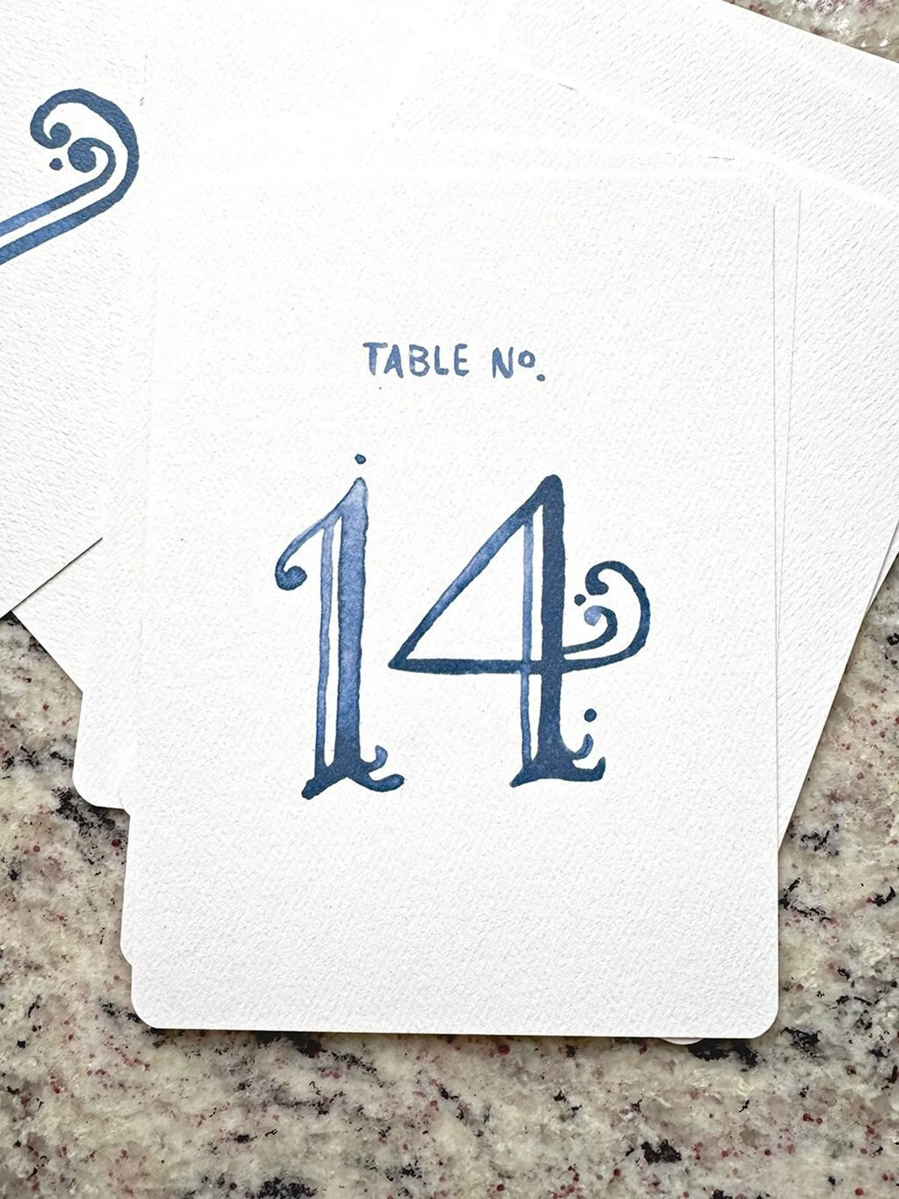
Table numbers
A refined rectangular design, printed on warm white paper and enhanced with pastel french blue script typography, will be elegantly presented on a wooden easel

Slide 17
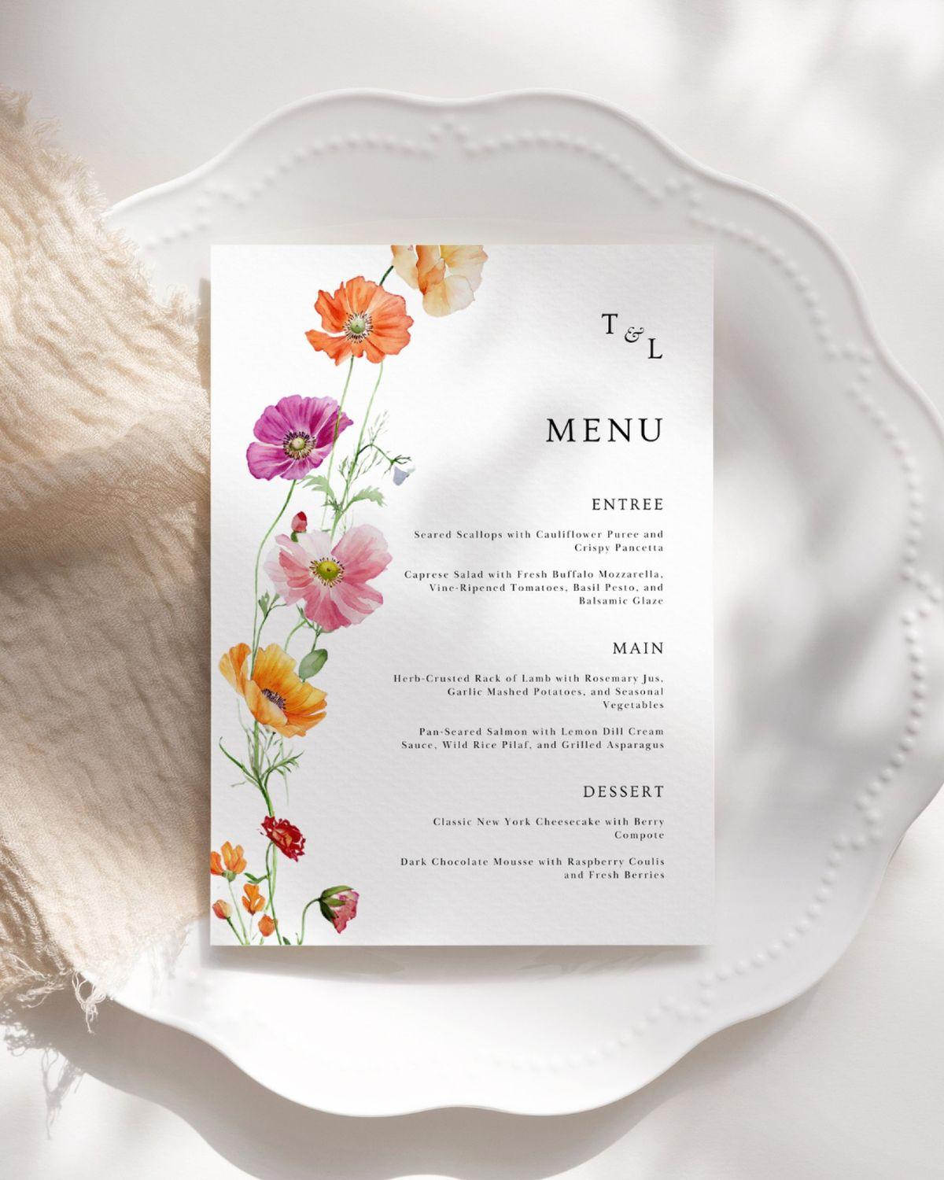
Menus
A large rectangular format, crafted from warm white, smooth, thick matte paper, featuring elegant dark script typography and enhanced with a pastel spring floral design for a sophisticated and harmonious touch

Slide 18
RECEPTION DÉCOR

Slide 19
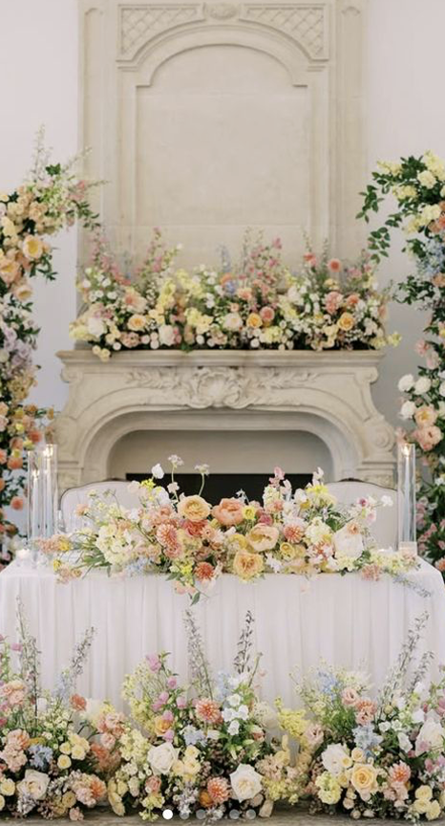
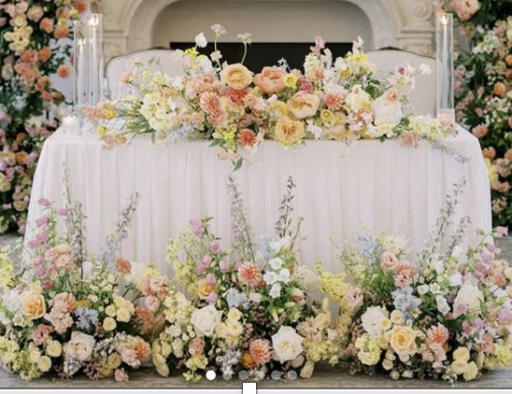
Bride & groom – Table For 2
The bride and groom’s table will be a rectangular table for two, styled to reflect the elegance of the guest tables while incorporating a distinctive statement element
The tabletop will be adorned from side to side with short taper candles, complemented by an elegant tablecloth
A large, medium floral arrangement will grace the table, accompanied by an additional arrangement at its base
Every detail is thoughtfully styled to harmonize seamlessly with the color palette detailed on slide #2, resulting in a warm, sophisticated, and unforgettable focal point

Slide 20
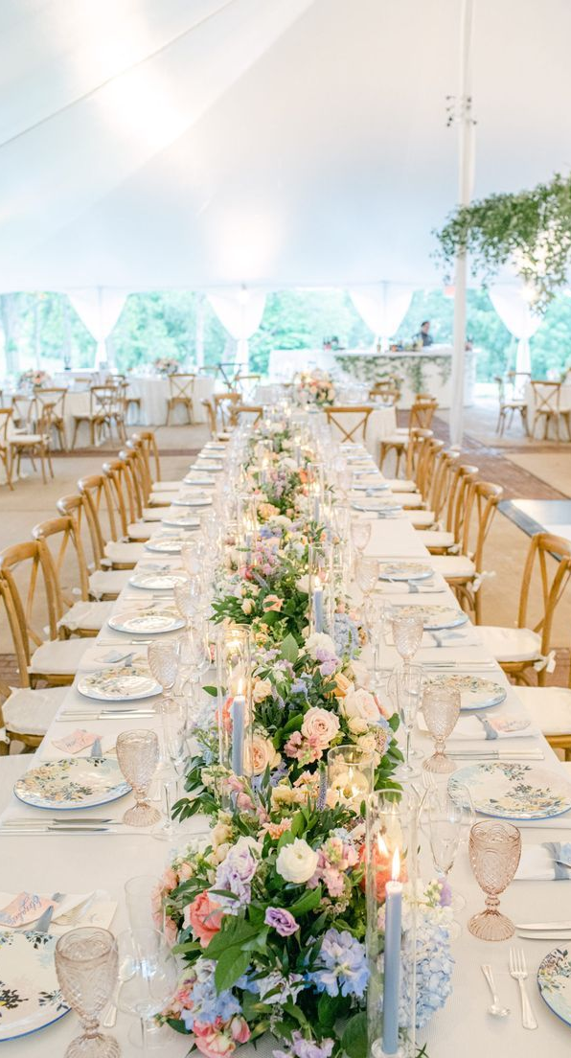
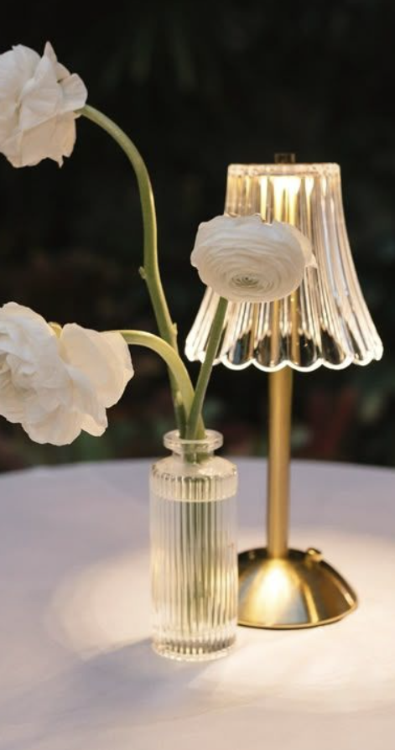
Rectangular Tables – OPTION 1
Rectangular tables (number of guests per side to be confirmed) will be dressed in warm white linens and adorned with a long light, airy floral garland running from side to side of the table.
These arrangements will incorporate short taper candles, complemented by vintage mini lamps.
The overall décor will reflect and harmonize with the color palette detailed on slide #2

Slide 21
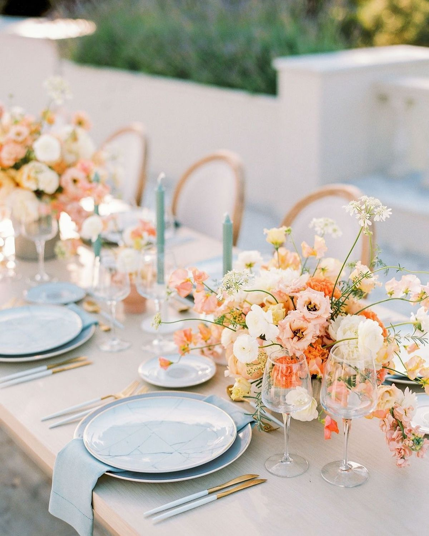
Round Tables – Option 2
For the 8 peoples round table décor, the aesthetic remains light, airy, and romantic. Each table will feature multiple medium-low, rounded floral arrangements, elegantly arranged from end to end in small vases and surrounded by short blue taper candles. A refined palette of pastel tones, soft whites, and lush greenery envelops the space, creating a warm, timeless, and effortlessly sophisticated ambiance

Slide 22
RENTALS

Slide 23
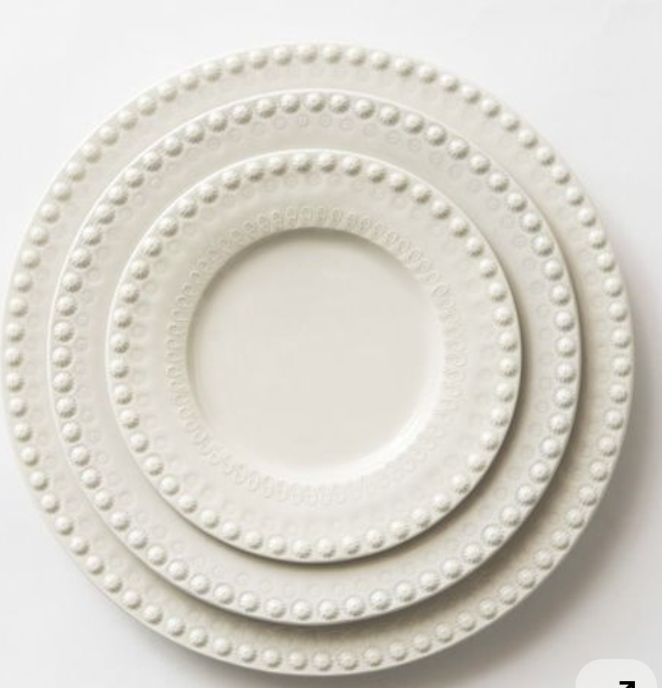
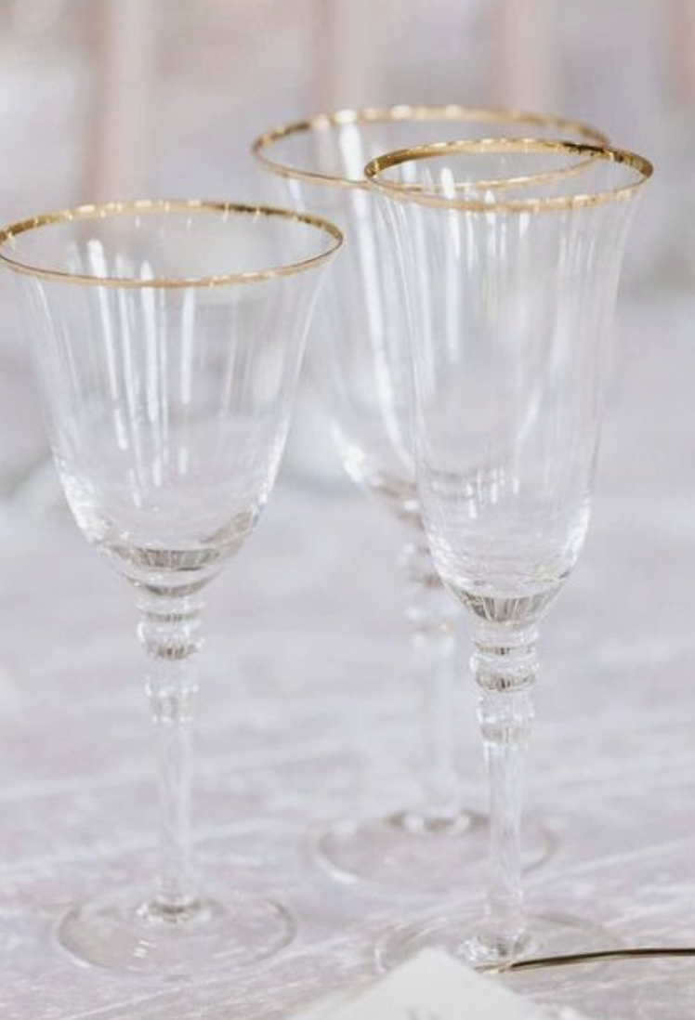
TABLEWARE
Ivory or gold rimmed charger plates will be selected based on rental availability, carefully chosen to match the reference image provided by the bride. Flatware provided by Le Cercle de l’Union Interalliée will complement the table setting, paired with delicate crystal glassware featuring gold rims and pastel blue napkins for a refined and harmonious touch

Slide 24
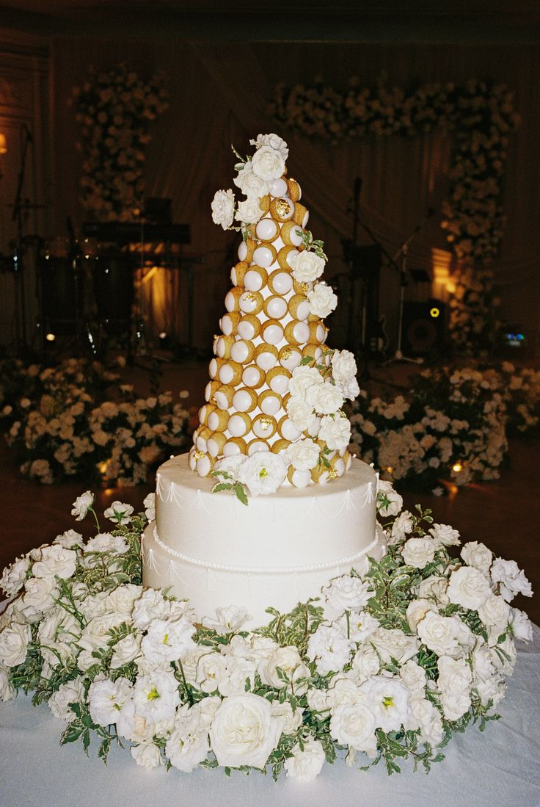
CROQUEMBOUCHE TOWER TABLE
The croquembouche tower table will be elegantly styled with refined floral arrangements that echo the overall décor and established color palette, creating a cohesive and sophisticated presentation

Slide 25
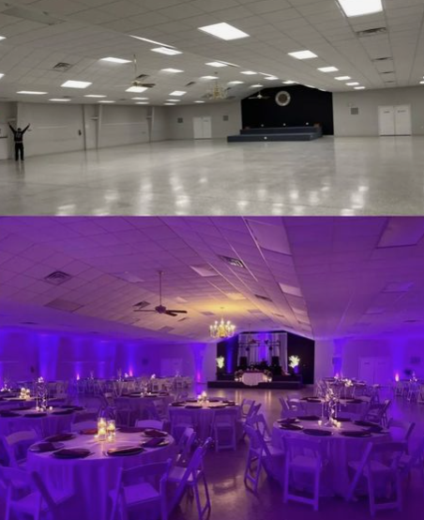
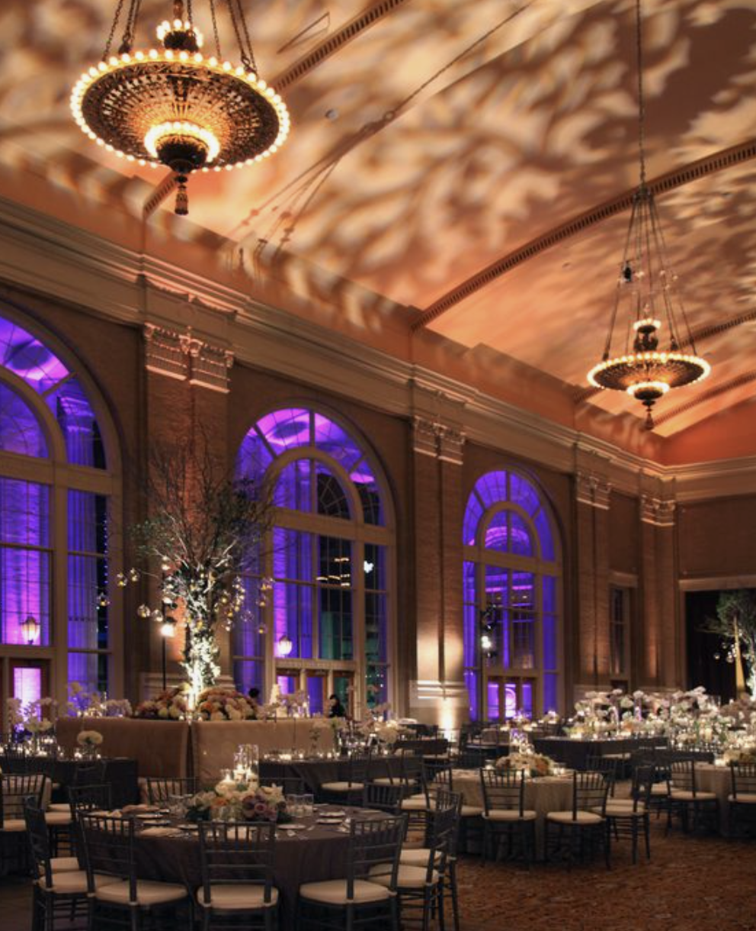
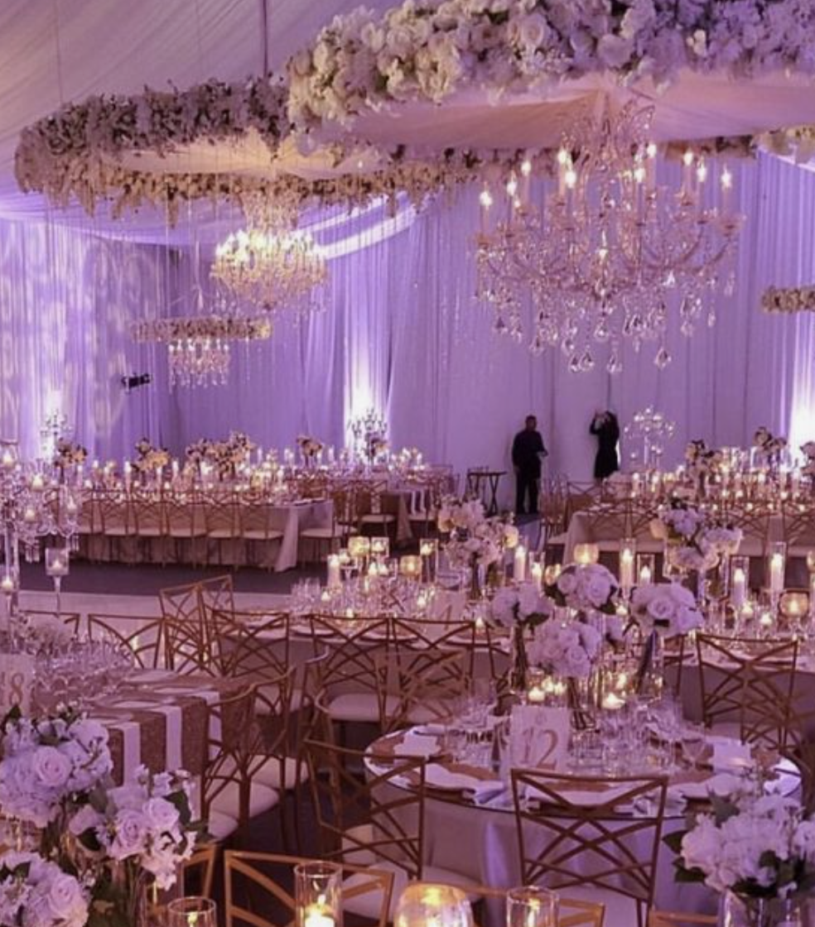
UP LITHING
Audrey’s Note: I highly recommend considering uplighting for your décor. It has a remarkable ability to enhance the overall ambiance by highlighting key elements and adding warmth to the space. Uplighting can truly transform your event, creating a captivating and inviting atmosphere that your guests will love.

Slide 26
FLOOR PLANS

Slide 27
RECEPTION/DINNER SEATING PLAN
The finalized floor plan will be shared upon confirmation of the final guest list

Slide 28
WELCOME DINNER
The welcome dinner will take place at Paris Seine.

Slide 29
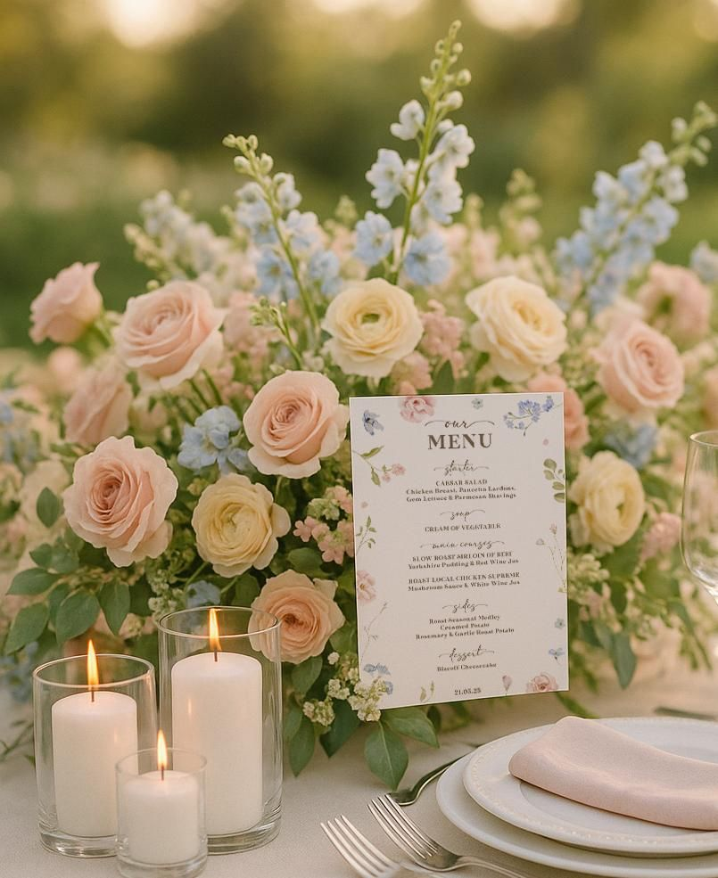
A pastel floral arrangement will be placed on each table, accompanied by a cluster of small votive candles, creating a light, sophisticated, and effortlessly elegant ambiance

Slide 30
We can’t wait to bring your vision to life!
The concepts (written and images) in this proposal are symbolic of the design inspiration we intend to bring to life for your event. Due to the characteristics of perishable items (flowers), there can be situations that may emerge that are completely out of our control.
To protect the integrity of our creativity, we kindly ask that you do not share the details of this proposal with other vendors bidding for your event. This was made just for you. However, please feel free to share this with your family.

Slide 31
NOTES FOR PLANNER AND FLORIST TEAM ONLY (FRENCH):
Décor de la Cérémonie + décor de l’allee a l’Eglise
1 Bouquet de mariée
1 Boutonnière du marié
3 Bouquets de demoiselles d'honneur
Décor de la Cérémonie + décor de l’allee a l’Eglise
TBD tables ronde (jusqu'à 10 invités par table) Nombre final a determiner
TBD longue tables rectangulaire Nombre final a determiner
8 décor Tables mange debout pour l'heure du cocktail
2 Décor de Bars (1 pour le cocktail - 1 pour la réception/fête)
1 décor pour le welcome sign / panneau de bienvenue
1 décor pour la Table “Welcome” Table
Re disposition des fleurs pour la table du Wedding Cake
1 décor pour la table buffet de dessert + drape blanc comme sur la photo
WELCOME DINNER
12 tables – Comme sur la photo

